Slide 1
Probability theory
Statistics

Slide 2
PROBABILITY THEORY AND STATISTICS
Hypothesis testing
https://web.williams.edu/Mathematics/sjmiller/public_html/BrownClasses/162/Handouts/StatsTests04.pdf?fbclid=IwAR0g5icx4vMOMfjPO4i3drEhBt8kc3F7g8YXRYMmicLwKAbu1a6PH68OVEY
Notes:
And standard deviation variance

Slide 3
PROBABILITY THEORY AND STATISTICS
Firings on border with weekly average data.
Notes:
And standard deviation variance

Slide 4
PROBABILITY THEORY AND STATISTICS
In hypothesis testing you suggest a statement about the data, and test it statistically with a confidence level.
By construct you either can reject the hypothesis or fail to reject (it is not the same as accepting). So when constructing we should have in mind the non desirable version to be able to reject it.
H₀ : null hypothesis (the one we want to reject)
H₁ : alternative hypothesis
Notes:
And standard deviation variance

Slide 5
PROBABILITY THEORY AND STATISTICS
Example:
170, 165, 180, 163, 174, 185, 176, 175, 172, 170
Data of height of students. If we want to test if on average students are higher than 170 we should construct hypothesis test in the following way.
H₀ : < 170
H₁ : ≥ 170
Notes:
And standard deviation variance

Slide 6
PROBABILITY THEORY AND STATISTICS
There are 2 types of tests` One-tailed and Two-tailed
One-tailed hypothesis test is used when you want to test if something is below or above a value.
Two-tailed hypothesis test used when you want to test if something can potentially have a certain value or not.
Notes:
And standard deviation variance

Slide 7
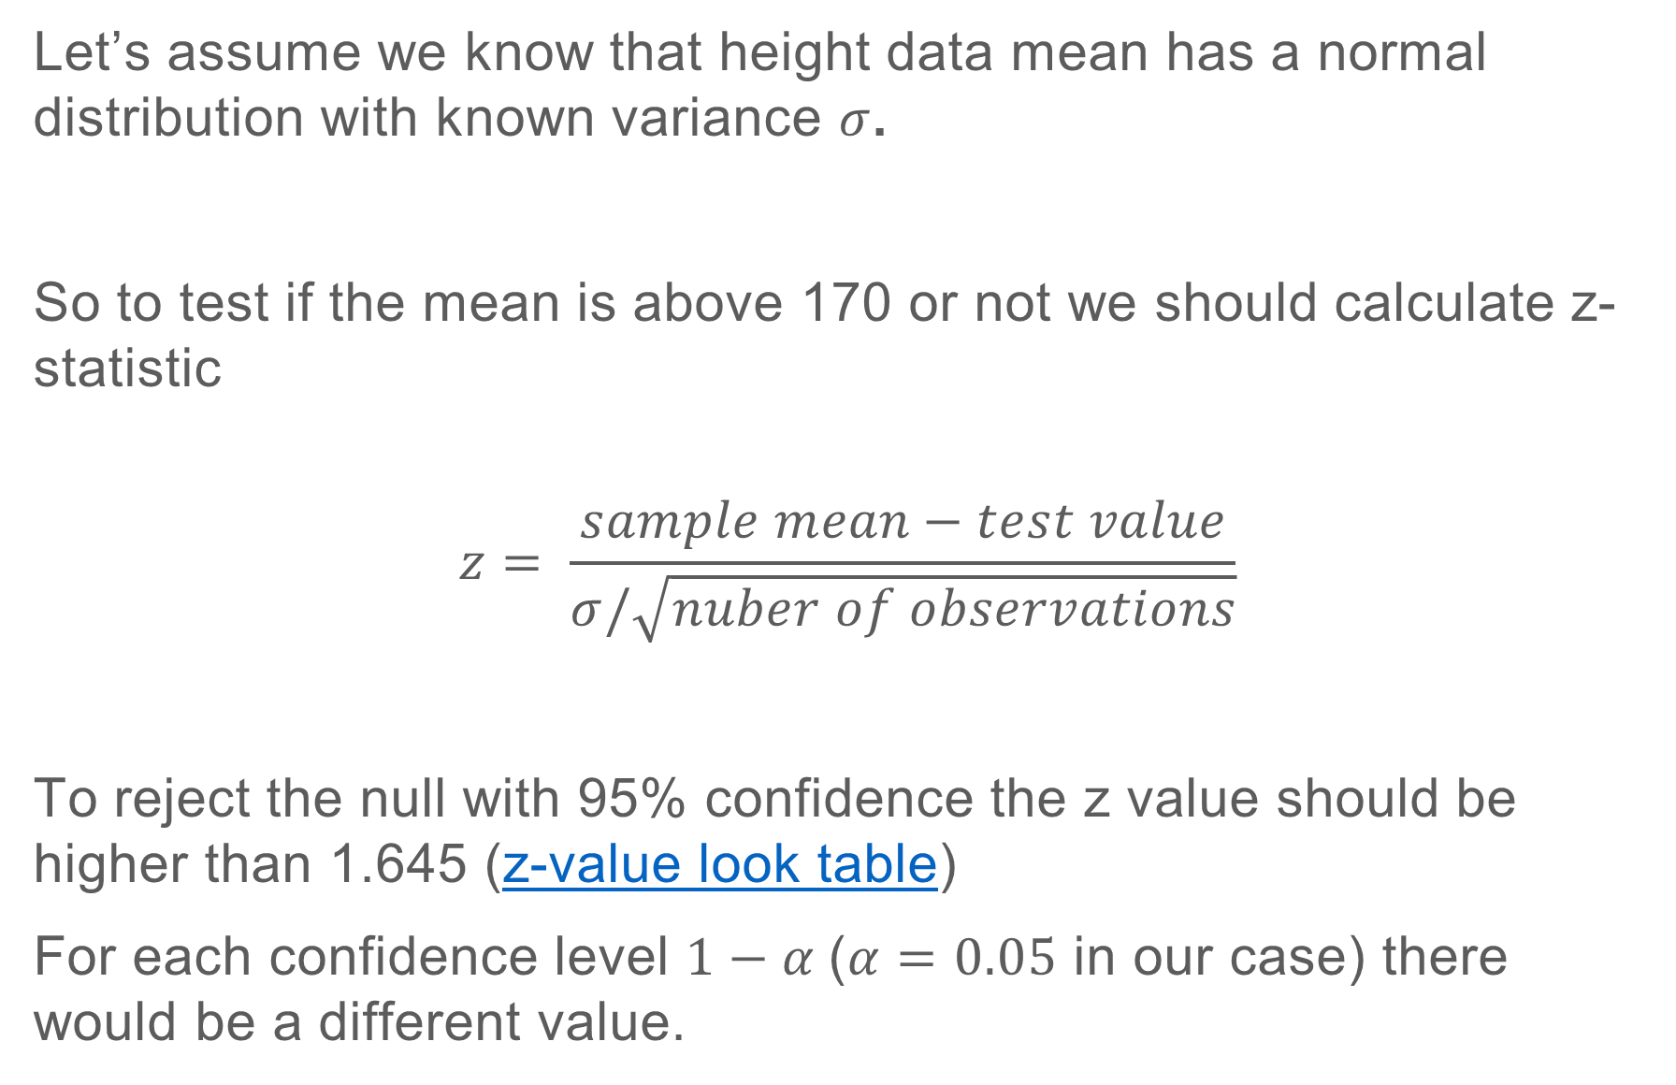
PROBABILITY THEORY AND STATISTICS
Let’s assume we know that height data mean has a normal distribution with known variance $σ$.
So to test if the mean is above 170 or not we should calculate z-statistic
$$z= \frac{sample mean−test value}{σ/\sqrt{nuber of observations}}$$
To reject the null with 95% confidence the z value should be higher than 1.645 (z-value look table)
For each confidence level $1−α$($α=0.05$ in our case) there would be a different value.
Notes:
And standard deviation variance

Slide 8
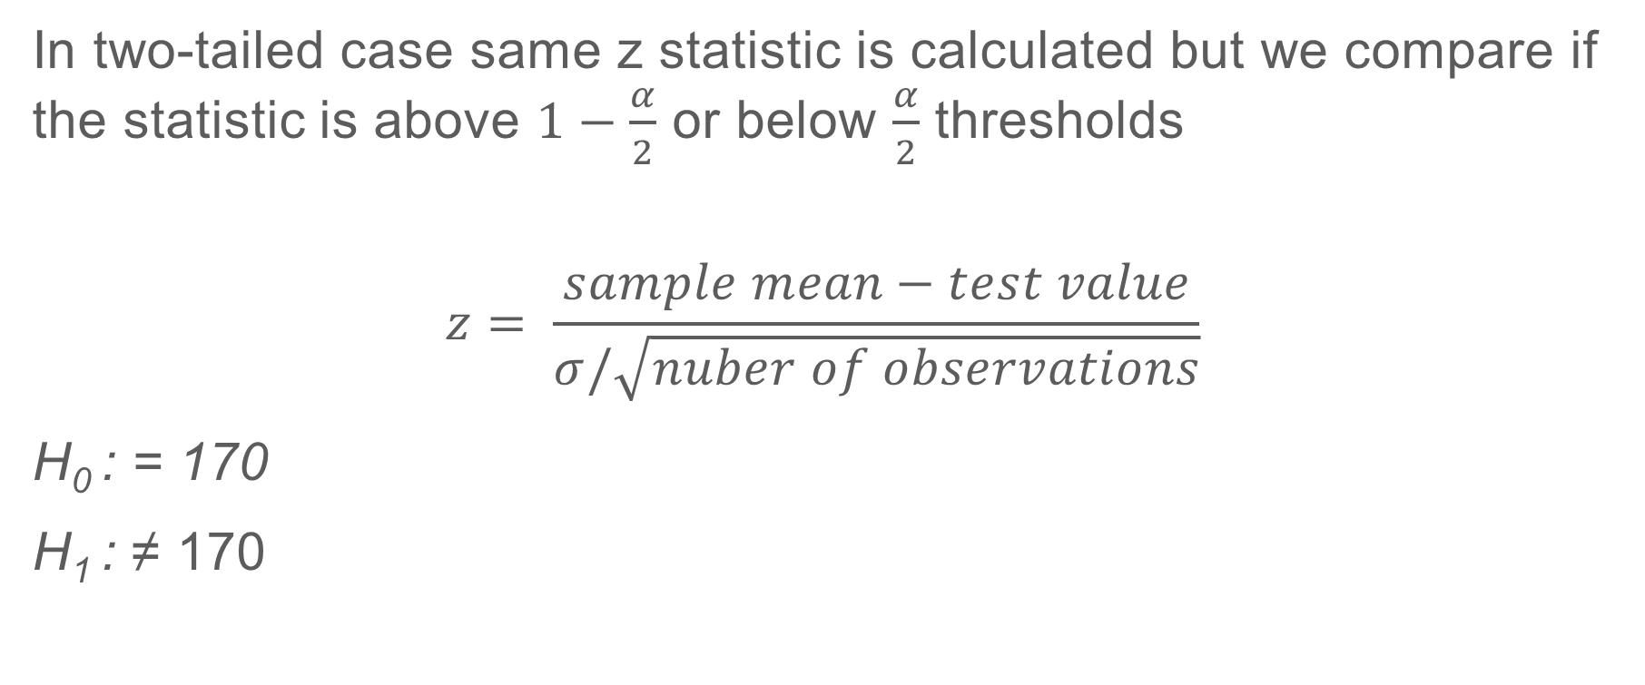
PROBABILITY THEORY AND STATISTICS
In two-tailed case same z statistic is calculated but we compare if the statistic is above $1−\frac{α}{2}$ or below $\frac{α}{2}$ thresholds
$$z= \frac{sample mean−test value}{σ/\sqrt{nuber of observations}}$$
H₀ : = 170
H₁ : ≠ 170
Notes:
And standard deviation variance

Slide 9
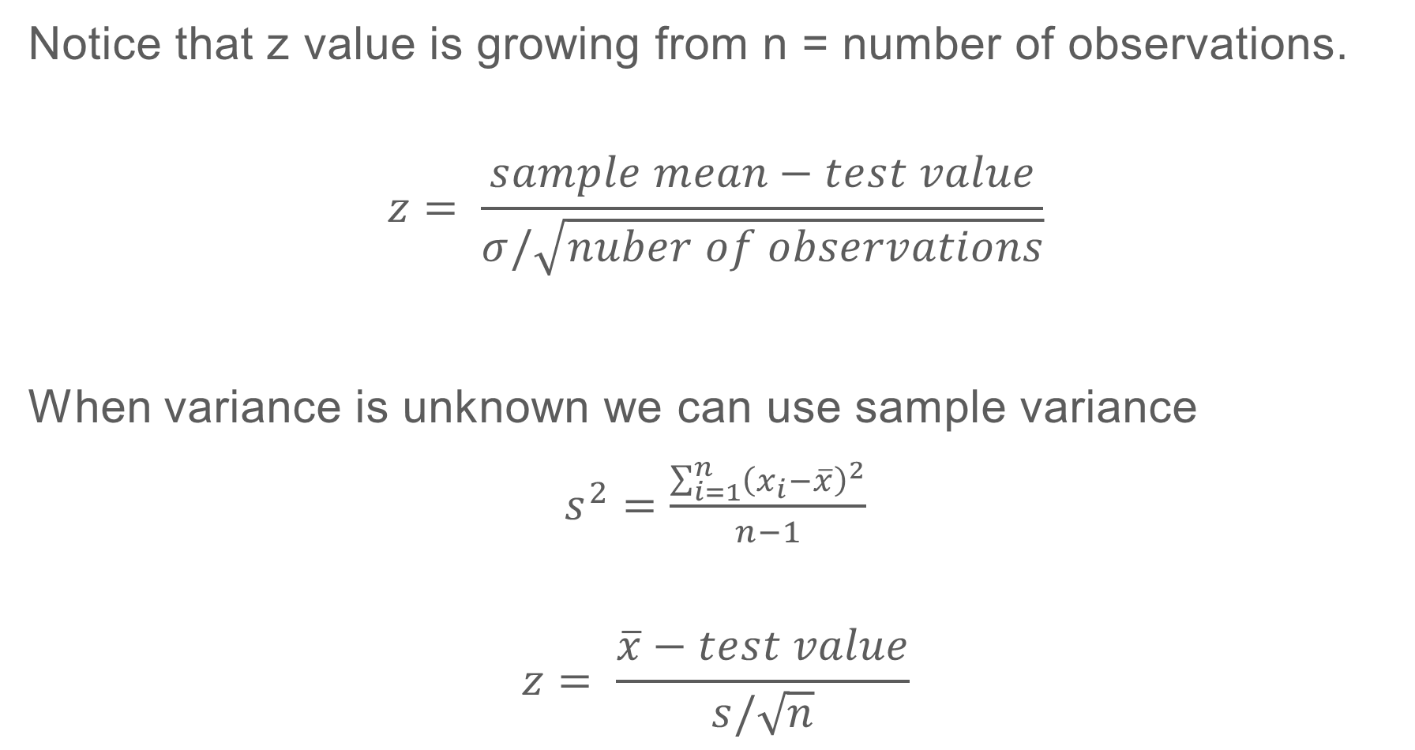
PROBABILITY THEORY AND STATISTICS
Notice that z value is growing from n = number of observations.
$$z= \frac{sample mean−test value}{σ/\sqrt{nuber of observations}}$$
When variance is unknown we can use sample variance
$s^{2}=\frac{\sum_{i=1}^{n}{{\left(x_{i}−\overline{x}\right)}^{2}}}{n−1}$
$$z= \frac{\overline{x}−test value}{s/\sqrt{n}}$$
Notes:
And standard deviation variance

Slide 10
PROBABILITY THEORY AND STATISTICS
Z test can either be used when n is large (more than 30 although there is a debate what is considered large) or when the underlying distribution is normal.
In other cases t-test is used. T distribution is a little bit more fat tailed, so it is more conservative than Normal distribution.
Notes:
And standard deviation variance

Slide 11
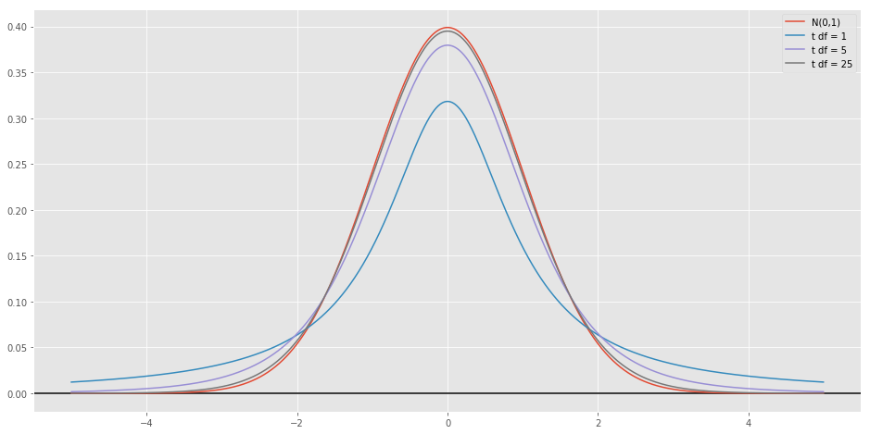
PROBABILITY THEORY AND STATISTICS
T distribution vs Normal.
T look-up table
Notes:
And standard deviation variance

Slide 12
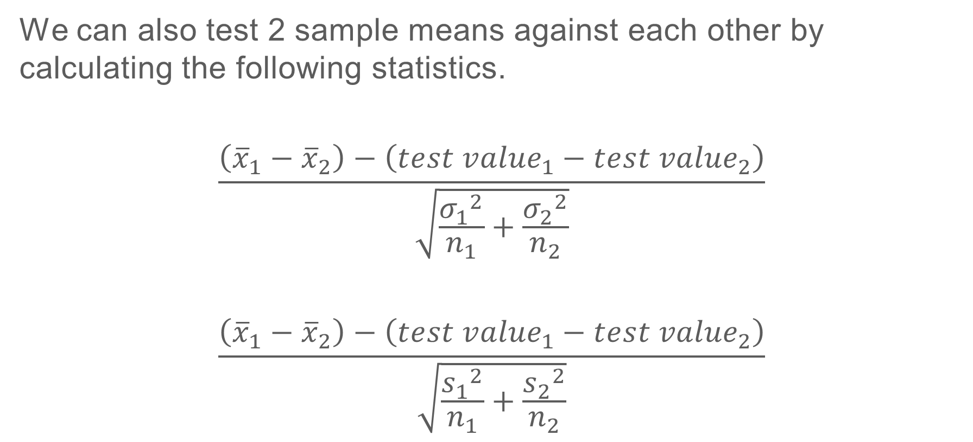
PROBABILITY THEORY AND STATISTICS
We can also test 2 sample means against each other by calculating the following statistics.
$$\frac{\left({\overline{x}}_{1}−{\overline{x}}_{2}\right)−\left({test value}_{1}−{test value}_{2}\right)}{\sqrt{\frac{{σ_{1}}^{2}}{n_{1}}+\frac{{σ_{2}}^{2}}{n_{2}}}}$$
$$\frac{\left({\overline{x}}_{1}−{\overline{x}}_{2}\right)−\left({test value}_{1}−{test value}_{2}\right)}{\sqrt{\frac{{s_{1}}^{2}}{n_{1}}+\frac{{s_{2}}^{2}}{n_{2}}}}$$
Notes:
And standard deviation variance

